Slide 1
ART × TECHNOLOGY / SPOKEN-WORD REHEARSAL
Hear the difference.
Keep your own voice.
A rehearsal partner that leaves artistic judgment with the performer.
Live app: speechtrace-lab.vercel.app
SpeechTrace · Suhas Beemineni · InnovArt 2027
01
Notes:
0:00–0:40 (40 seconds). I am Suhas Beemineni. SpeechTrace is a rehearsal tool for spoken-word performance. A quiet line or a pause can carry meaning. My goal is to help a performer locate a difference, hear it in context, and decide what it means for their own next take. The tool compares recordings; it does not decide whether a performance is good. This working prototype extends an earlier speech-comparison project with a performer-authored rehearsal workflow. Sources: https://speechtrace-lab.vercel.app/docs.html ; https://github.com/suhaslord/blob/tree/main/speechtrace . October 7 additions, not a new acoustic model.

Slide 2
THE ARTISTIC PROBLEM
A difference is not always a mistake.
Measured evidence
Where did volume, pacing or pitch movement change?
Performer interpretation
Was it intentional? Is it worth practicing? What should the next take explore?
SpeechTrace · Suhas Beemineni · InnovArt 2027
02
Notes:
0:40–1:30 (50 seconds). A numeric comparison can reward imitation. In performance, however, a deliberate pause, a restrained volume, or a changed rhythm may be expressive. A model sees a difference but cannot infer that intention reliably. This project gives two separate views: measured evidence and the performer’s interpretation. The reference is a comparison point, not an artistic authority. The specific target user is someone rehearsing spoken text who wants concrete moments to listen to, rather than a vague score. No interviews or adoption numbers are claimed. Sources: https://speechtrace-lab.vercel.app/docs.html ; https://github.com/suhaslord/blob/tree/main/speechtrace . October 7 additions, not a new acoustic model.

Slide 3
THE WORKING WORKFLOW
Listen → decide → rehearse.
01 Compare two short recordings
02 Hear the flagged passage in context
03 Write an intention and interpret the difference
04 Export a plan for the next take
SpeechTrace · Suhas Beemineni · InnovArt 2027
03
Notes:
1:30–2:20 (50 seconds). First choose a bundled example or provide two short recordings and their shared transcript. The engine highlights an interval and connects it with estimated words. Listen to both versions. Then write an intention for your next take. For each moment, choose intentional, practice this passage, or review later. Export notes that preserve your intention, your decision, the interval and the words. Those notes do not change the score. When recordings or analysis change, old notes clear so they cannot be confused with feedback about a new take. Sources: https://speechtrace-lab.vercel.app/docs.html ; https://github.com/suhaslord/blob/tree/main/speechtrace . October 7 additions, not a new acoustic model.

Slide 4
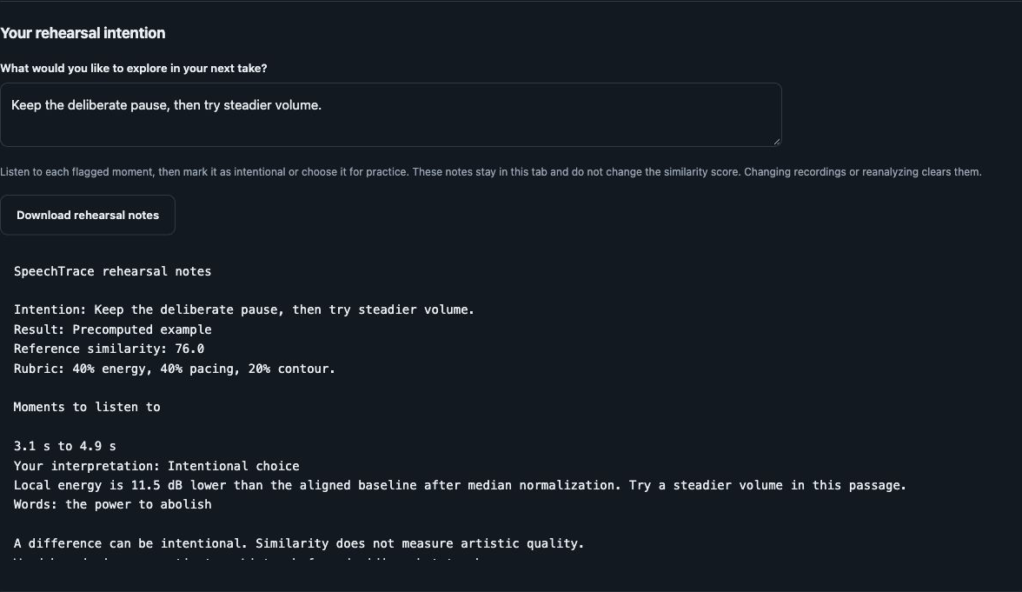
LIVE PRODUCT / OCTOBER 7 ADDITION
The performer’s decision is visible.
“Intentional choice”
Reference similarity
stays 76.0.
SpeechTrace · Suhas Beemineni · InnovArt 2027
04
Notes:
2:20–3:20 (60 seconds). Switch to the live app. Load the moderate-volume example. The score is 76.0 and the flagged passage is approximately 3.1 to 4.9 seconds. Play the reference and participant at that interval. Write: Keep the deliberate pause, then try steadier volume. Mark the passage Intentional choice. Point out that the score stays 76.0. Click Download rehearsal notes and show the on-screen preview. The screenshot in this slide is the real working interface with those values, not a product mockup. If the network is unavailable, use this screenshot and describe the same verified flow. Sources: https://speechtrace-lab.vercel.app/docs.html ; https://github.com/suhaslord/blob/tree/main/speechtrace . October 7 additions, not a new acoustic model.

Slide 5
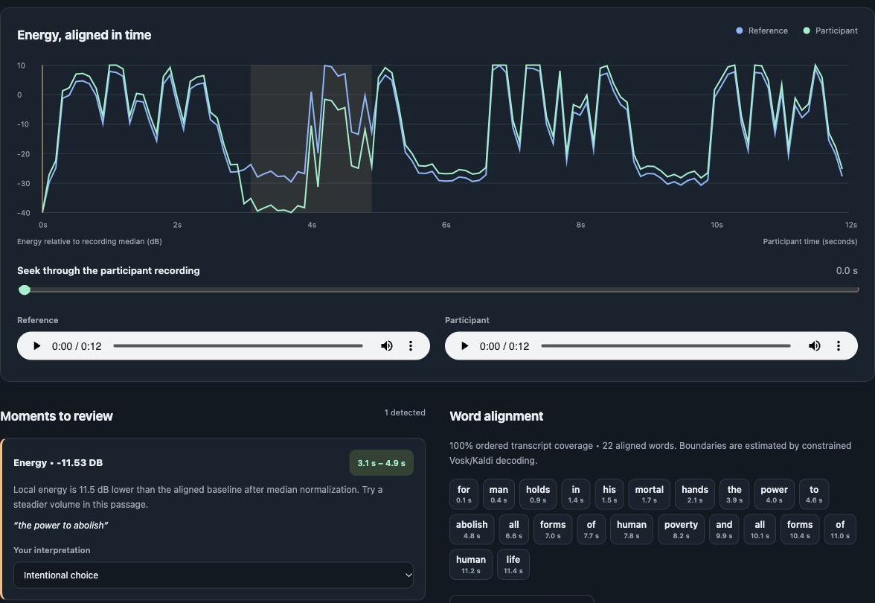
IMPLEMENTATION / INTERPRETABLE OUTPUT
Evidence points to a moment.
40% energy
40% pacing
20% contour
An explicit similarity rubric
SpeechTrace · Suhas Beemineni · InnovArt 2027
05
Notes:
3:20–4:15 (55 seconds). The Python pipeline uses acoustic features and dynamic time warping to align recordings. Median-normalized energy helps distinguish a local volume change from a whole-recording gain difference. Relative pitch and local pacing contribute to an explicit rubric: forty percent energy, forty percent pacing, twenty percent contour. A pretrained Vosk model estimates word boundaries against the supplied transcript. Clicking an interval or word seeks to that part of the recording. Precomputed examples are labeled; Reanalyze invokes the real backend. These estimated boundaries are imperfect, so listening remains essential. Sources: https://speechtrace-lab.vercel.app/docs.html ; https://github.com/suhaslord/blob/tree/main/speechtrace . October 7 additions, not a new acoustic model.

Slide 6
EVALUATION / HONEST LIMITS
A controlled demo, not proof of artistry.
14 controlled pairs · one speaker
4 unchanged / global-gain controls: no flags
Mean interval overlap: 0.975 volume · 0.815 pauses
Next: consenting artists, independent raters,
separate speakers, uncertainty and false positives.
SpeechTrace · Suhas Beemineni · InnovArt 2027
06
Notes:
4:15–5:10 (55 seconds). Evaluation uses fourteen pairs made from two public-domain excerpts of one historical speaker. Some recordings have deliberately modified volume, pauses or speed. Four unchanged or global-gain controls produced no flags. Average interval overlap was 0.975 for the moderate and severe volume edits, and 0.815 for inserted pauses. Those numbers measure detection of known artificial edits. They do not measure artistic quality, fairness, usefulness to poets, or performance across different speakers. A stronger study would use consenting performers, independently annotated moments, separate calibration and evaluation speakers, and false-positive reporting. That study has not yet been done. Sources: https://speechtrace-lab.vercel.app/docs.html ; https://github.com/suhaslord/blob/tree/main/speechtrace . October 7 additions, not a new acoustic model.

Slide 7
WHAT IS NEW / WHAT REMAINS LIMITED
Private notes. Clear provenance.
New: intentions, decisions and rehearsal-note export
Existing: alignment engine and controlled dataset
Disclosed: prior entry, pretrained model, Codex assistance
Private notes: tab memory; reset with stale analysis
SpeechTrace · Suhas Beemineni · InnovArt 2027
07
Notes:
5:10–6:05 (55 seconds). The original engine was built October 6, 2026 for Multimodal AI Track C and submitted there. The October 7 extension adds rehearsal intentions, intentional-or-practice decisions, downloadable notes and an arts-specific guide. Codex assisted with implementation and writing; the Vosk acoustic model is pretrained. Notes stay in browser memory until the user downloads them. Uploaded audio and transcripts are processed for a request without application persistence, though hosting request metadata exists. This prototype is not a diagnosis tool or an absolute assessment of a speaker. These disclosures keep the project’s actual contribution and limitations reviewable. Sources: https://speechtrace-lab.vercel.app/docs.html ; https://github.com/suhaslord/blob/tree/main/speechtrace . October 7 additions, not a new acoustic model.

Slide 8
OUTCOME / QUESTIONS
One useful next take.
Hear a moment.
Choose what to keep.
Plan what to practice.
App: speechtrace-lab.vercel.app
Arts guide: speechtrace-lab.vercel.app/innovart.html
Source: github.com/suhaslord/blob/tree/main/speechtrace
SpeechTrace · Suhas Beemineni · InnovArt 2027
08
Notes:
6:05–7:00 (55 seconds), followed by approximately 3 minutes of Q&A. Close by returning to the intended outcome: the performer has a specific passage to listen to and a plan they authored themselves. The actual app, source, technical report and rehearsal guide are public and accessible. This is a working prototype, not a proposal alone. If asked about artistic value, explain that the workflow preserves intent and must still be tested with performers. If asked about a low score, say it means a difference from one reference. If asked about future work, prioritize validation with diverse consenting artists and manually checked timing before wider claims. Confirm the presentation date and session time through the event’s Discord schedule; this deck does not complete the mandatory live presentation. Event requirements: https://innovart2027.devpost.com/ . Sources: https://speechtrace-lab.vercel.app/docs.html ; https://github.com/suhaslord/blob/tree/main/speechtrace . October 7 additions, not a new acoustic model.

